Slide 1
Exam Two Study Guide
Dr. Helen Wei

Slide 2
Date and Time
Date: April 5th, 2021
Time: Any time during the day on April 5th, 2021
Part I: 60 minutes and Part II 45 minutes
As it may exceed the class time slots, please plan ahead before you start your exam
I will be in class during your class time
Online

Slide 3
Exam Format
Online Exam
Open book, open notes, close internet

Slide 4
Question Types
Multiple Choice (~20)
True/False (~10)
Free format(2)
Programming Question (1)

Slide 5
Knowledge Coverage
Chapter 3 - Stack
Chapter 4 - Queue

Slide 6
Knowledge Coverage in Detail
Stack storage policy and application
Stack implementation (array stack)
Queue storage policy and application
Queue implementation (array queue and list queue)

Slide 7
How to prepare for the example
Go over the three course slides posted on the Blackboard → Course slides → ch03, ch04 Go over homework
Go over the three lab assignments

Slide 8
Chapter 3
Stack storage policy and application
Stack implementation (array stack)

Slide 9
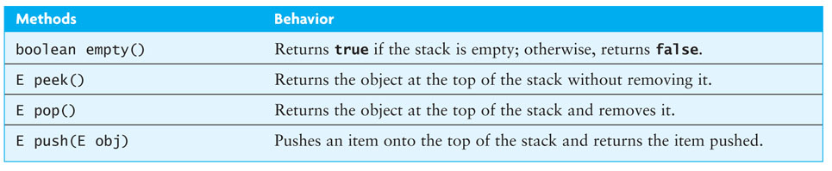
Specification of the Stack Abstract Data Type
Only the top element of a stack is visible; therefore the number of operations performed by a stack are few
We need the ability to
test for an empty stack (empty)
inspect the top element (peek)
retrieve the top element (pop)
put a new element on the stack (push)

Slide 10
Finding Palindromes
Palindrome: a string that reads identically in either direction, letter by letter (ignoring case)
kayak
"I saw I was I"
“Able was I ere I saw Elba”
"Level madam level"
Problem: Write a program that reads a string and determines whether it is a palindrome

Slide 11
Finding Palindromes (cont.)
import java.util.*;
public class PalindromeFinder {
private String inputString;
private Stack<Character> charStack = new Stack<Character>();
public PalindromeFinder(String str) {
inputString = str;
fillStack(); // fills the stack with the characters in inputString
}
...

Slide 12
Finding Palindromes (cont.)
Solving using a stack:
Push each string character, from left to right, onto a stack
k
a
y
a
k
k
k
a
a
y
y
a
a
k
k
k
a
y
a
k
a
y
private void fillStack() {
for(int i = 0; i < inputString.length(); i++) {
charStack.push(inputString.charAt(i));
}
}
k
a
k

Slide 13
Finding Palindromes (cont.)
Solving using a stack:
Pop each character off the stack, appending each to the StringBuilder result
k
a
y
k
a
y
k
a
a
k
a
k
a
y
y
k
a
y
a
k
k
a
a
k
private String buildReverse(){
StringBuilder result = new StringBuilder();
while(!charStack.empty()) {
result.append(charStack.pop());
}
return result.toString();
}
k

Slide 14
Finding Palindromes (cont.)
...
public boolean isPalindrome() {
return inputString.equalsIgnoreCase(buildReverse());
}
}

Slide 15
Finding Palindromes (cont.)
Listing 4.2 (PalindromeFinder.java, page?)

Slide 16
Testing
To test this class using the following inputs:
a single character (always a palindrome)
multiple characters in a word
multiple words
different cases
even-length strings
odd-length strings
the empty string (considered a palindrome)

Slide 17
Balanced Parentheses
When analyzing arithmetic expressions, it is important to determine whether an expression is balanced with respect to parentheses
( a + b * ( c / ( d – e ) ) ) + ( d / e )
The problem is further complicated if braces or brackets are used in conjunction with parentheses
The solution is to use stacks!

Slide 18
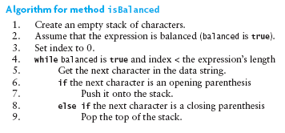

Balanced Parentheses (cont.)

Slide 19
Testing
Provide a variety of input expressions displaying the result true or false
Try several levels of nested parentheses
Try nested parentheses where corresponding parentheses are not of the same type
Try unbalanced parentheses
No parentheses at all!
PITFALL: attempting to pop an empty stack will throw an EmptyStackException. You can guard against this by either testing for an empty stack or catching the exception

Slide 20
Implementing a Stack Using an Array
If we implement a stack as an array, we would need . . .
public class ArrayStack<E> implements StackInt<E> {
private E[] theData;
int topOfStack = -1;
private static final int INITIAL_CAPACITY = 10;
@SupressWarnings("unchecked")
public ArrayStack() {
theData = (E[])new Object[INITIAL_CAPACITY];
}
Allocate storage for an array with a default capacity
Keep track of the top of the stack (subscript of the element at the top of the stack; for empty stack = -1)
There is no size variable or method

Slide 21
Implementing a Stack Using an Array (cont.)
Character
Object[]
value = 'J'
ArrayStack
[0] = null
[1] = null
[2] = null
[3] = null
[4] = null
[5] = null
[6] = null
[7] = null
[8] = null
[9] = null
Character
theData =
topOfStack = -1
3
0
1
2
value = 'a'
Character
value = 'v'
public E push(E obj) {
if (topOfStack == theData.length - 1){
reallocate();
}
topOfStack++;
theData[topOfStack] = obj;
return obj;
}
Character
value = 'a'

Slide 22
Implementing a Stack Using an Array (cont.)
@Override
public E pop() {
if (empty()) {
throw new EmptyStackException();
}
return theData[topOfStack--];
}

Slide 23
Implementing a Stack Using an Array (cont.)
This implementation is O(1), in contrast to the Pez analogy and the “kayak” example, which are both O(n)

Slide 24
Evaluating Postfix Expressions (cont.)
Testing: write a driver which
creates a PostfixEvaluator object
reads one or more expressions and report the result
catches PostfixEvaluator.SyntaxErrorException
exercises each path by using each operator
exercises each path through the method by trying different orderings and multiple occurrences of operators
tests for syntax errors:
an operator without any operands
a single operand
an extra operand
an extra operator
a variable name
the empty string

Slide 25
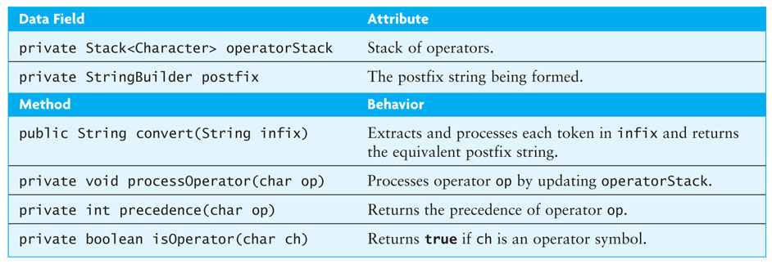
Converting from Infix to Postfix
Convert infix expressions to postfix expressions
Assume:
expressions consists of only spaces, operands, and operators
space is a delimiter character
all operands that are identifiers begin with a letter or underscore
all operands that are numbers begin with a digit

Slide 26
Converting from Infix to Postfix (cont.)
Example: convert
w – 5.1 / sum * 2
to its postfix form
w 5.1 sum / 2 * -

Slide 27
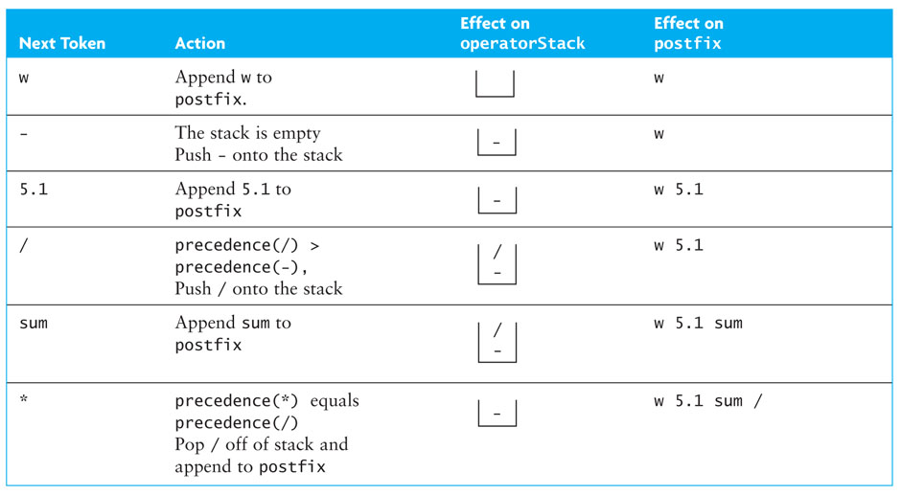
Converting from Infix to Postfix (cont.)

Slide 28
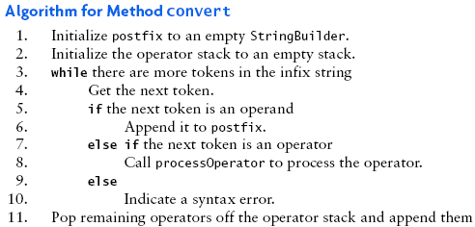
Converting from Infix to Postfix (cont.)

Slide 29
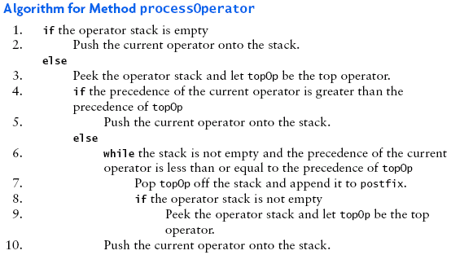
Converting from Infix to Postfix (cont.)

Slide 31
Chapter 4
Queue storage policy and application
Queue implementation (array queue and list queue)

Slide 32
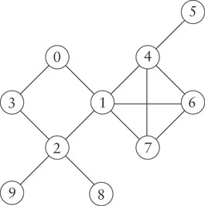
Using a Queue for Traversing a Multi-Branch Data Structure
A graph models a network of nodes, with links connecting nodes to other nodes in the network
A node in a graph may have several neighbors
Programmers doing a breadth-first traversal often use a queue to ensure that nodes closer to the starting point are visited before nodes that are farther away
You can learn more about graph traversal in Chapter 10

Slide 33
Queue
The queue, like the stack, is a widely used data structure
A queue differs from a stack in one important way
A stack is LIFO list – Last-In, First-Out
while a queue is FIFO list, First-In, First-Out

Slide 34
Implementing a Stack with a List Component
We can write a class, ListStack, that has a List component (in the example below, theData)
We can use either the ArrayList, Vector, or the LinkedList classes, as all implement the List interface. The push method, for example, can be coded as
public E push(E obj) {
theData.add(obj);
return obj;
}
A class which adapts methods of another class by giving different names to essentially the same methods (push instead of add) is called an adapter class
Writing methods in this way is called method delegation

Slide 35
Implementing a Stack with a List Component (cont.)
Listing 4.4 (ListStack.java, pages ?)

Slide 36
Using a Queue for Traversing a Multi-Branch Data Structure
A graph models a network of nodes, with links connecting nodes to other nodes in the network
A node in a graph may have several neighbors
Programmers doing a breadth-first traversal often use a queue to ensure that nodes closer to the starting point are visited before nodes that are farther away
You can learn more about graph traversal in Chapter 10

Slide 37
Class LinkedList Implements the Queue Interface
The LinkedList class provides methods for inserting and removing elements at either end of a double-linked list, which means all Queue methods can be implemented easily
The Java 5.0 LinkedList class implements the Queue interface
Queue<String> names = new LinkedList<String>();
creates a new Queue reference, names, that stores references to String objects
The actual object referenced by names is of type LinkedList<String>, but because names is a type Queue<String> reference, you can apply only the Queue methods to it

Slide 38
Implementing a Queue Using a Circular Array
The time efficiency of using a single- or double-linked list to implement a queue is acceptable
However, there are some space inefficiencies
Storage space is increased when using a linked list due to references stored in the nodes
Array Implementation
Insertion at rear of array is constant time O(1)
Removal from the front is linear time O(n)
Removal from rear of array is constant time O(1)
Insertion at the front is linear time O(n)
We now discuss how to avoid these inefficiencies in an array

Slide 39
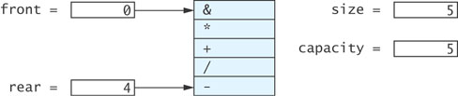
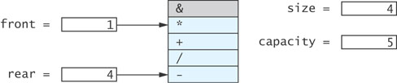
Implementing a Queue Using a Circular Array (cont.)

Slide 40
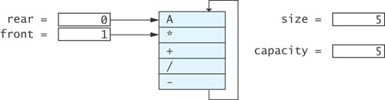
Implementing a Queue Using a Circular Array (cont.)

Slide 41
Implementing a Queue Using a Circular Array (cont.)
ArrayQueue q = new ArrayQueue(5);
front = 0
size = 0
capacity = 5
public ArrayQueue(int initCapacity) {
capacity = initCapacity;
theData = (E[])new Object[capacity];
front = 0;
rear = capacity – 1;
size = 0;
}
rear = 4

Slide 42
Implementing a Queue Using a Circular Array (cont.)
q.offer('/');
size = 2
front = 0
*
3
capacity = 5
rear = 1
+
rear = 2
/
public boolean offer(E item) {
if (size == capacity) {
reallocate();
}
size++;
rear = (rear + 1) % capacity;
theData[rear] = item;
return true;
}

Slide 43
Implementing a Queue Using a Circular Array (cont.)
next = q.poll();
size = 4
*
3
capacity = 5
front = 1
+
front = 2
/
-
public E poll() {
if (size == 0) {
return null
}
E result = theData[front];
front = (front + 1) % capacity;
size--;
return result;
}
rear = 4
A
result = '+'

